Slide 1

CODE REFACTORING AND BUG FIXING REPORT
ON
NOTE TAKING APPLICATION
Chirudeep Sanchula

Slide 2
CONTENTS:
Problem Statement
Code before Bug Detection
Detecting the Bug
Debugging the Code
Adding more functionality
Final Output

Slide 3
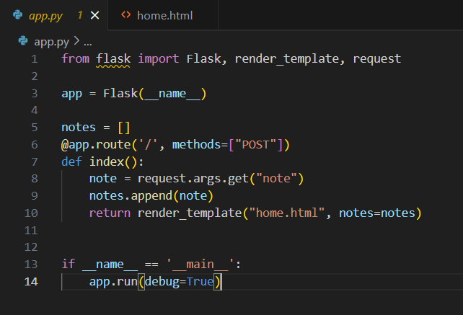
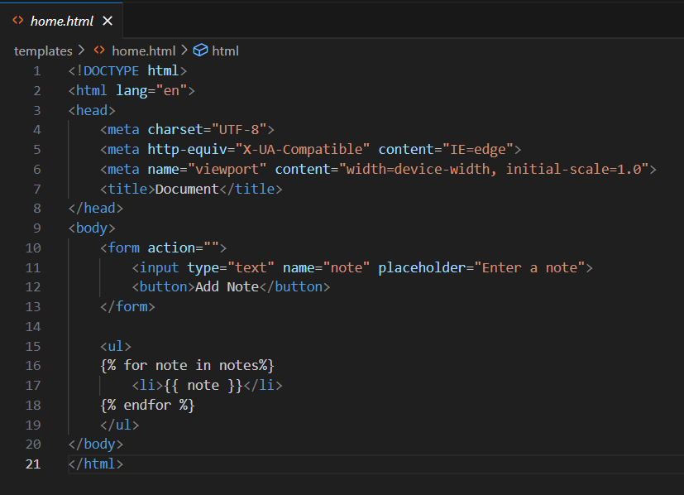
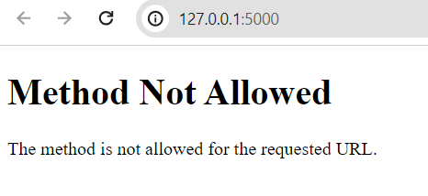
Code Before Bug Detection:
Python Code:
HTML Code:
Output before correction:

Slide 4
Detecting the bug: Python file
The method is set to be “POST”. This is used to write the data using a request but it should also be able to read the data from the server using a request.
Also the data transfer here is done using the HTML Form element.

Slide 5
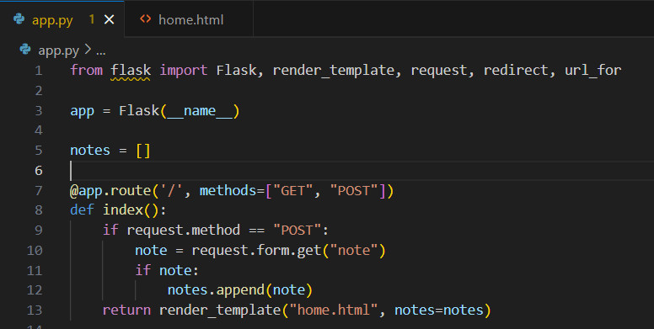
Fixing the bug: Python File
“GET” method parameter needs to be added.
To take data only with content instead of empty data, we need to check if the note has some data only then it gets appended.

Slide 6
Detecting the bug: HTML File
Here, in the Form element the Method is missing and the button type in the button element is missing

Slide 7
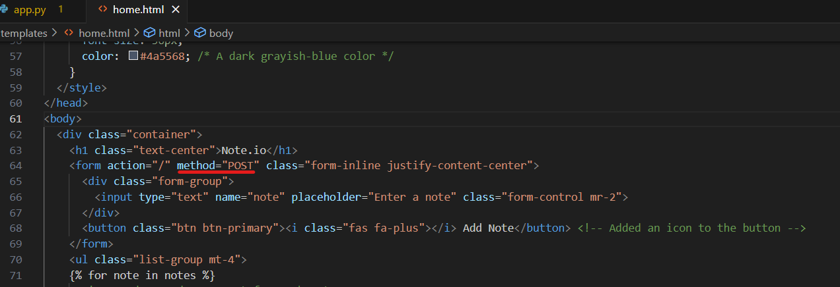
Fixing the bug: HTML file
The method is set to be “POST”. A button type is added to the button element.

Slide 8
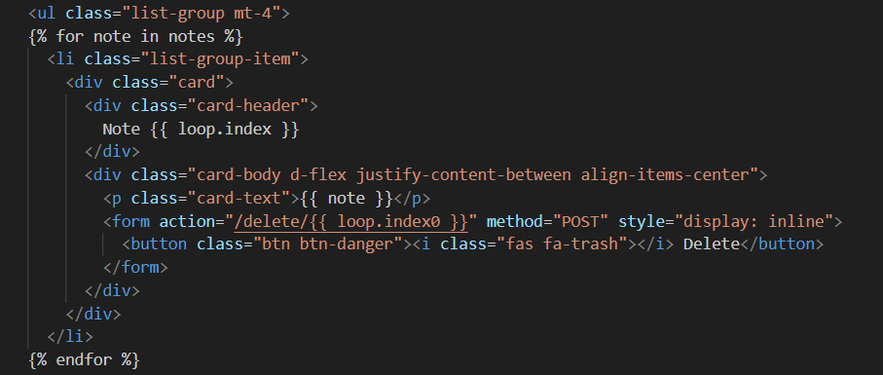
Adding further functionality:
Adding a Delete button which enables us to delete the notes that have been added.
Provided a UI to the app such that the app looks better to use.

Slide 9
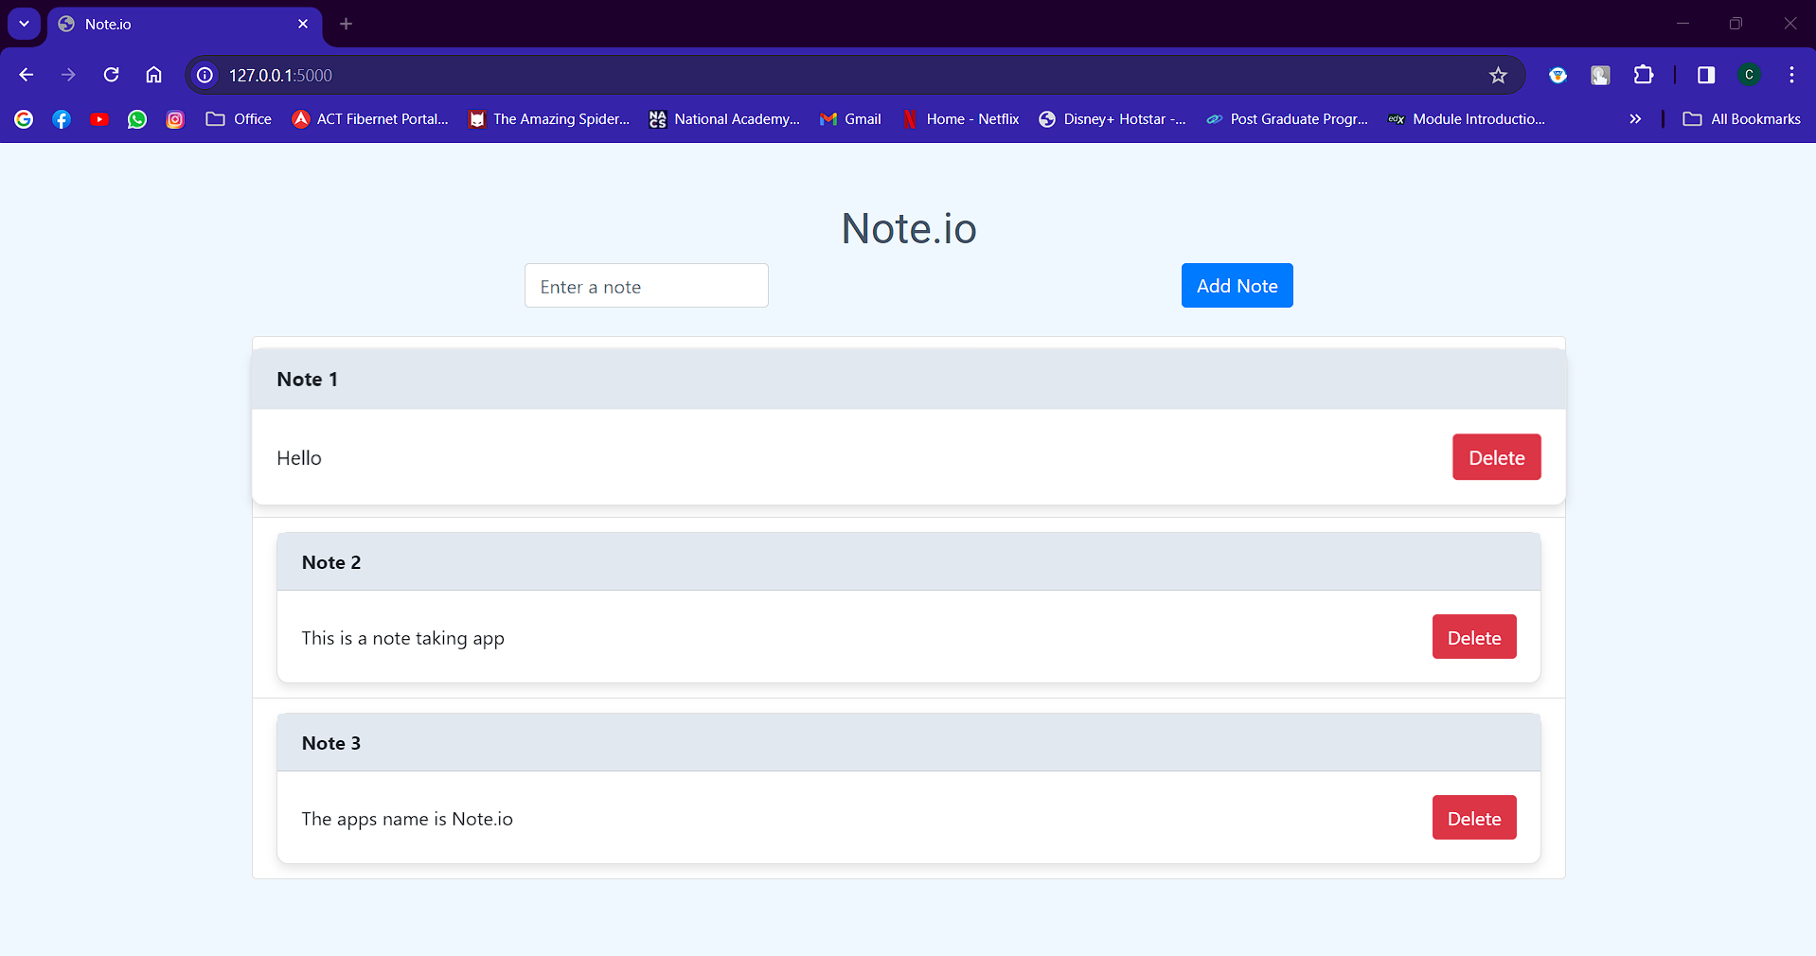
Final Output:

Slide 10

THANK YOU

